Slide 1
Capstone Project: Flippio
Content: It is a quiz platform for students and teachers that focuses on the multiple choice question.
Inspirations: GradeChum, Quizziz, Quizlet, Duolingo
Font Style: Montserrat,
Color Palette:
#c2eec7
#6892A4
#a3abf9
#72f5a6
#f7efd2
#E9E5D2
#EDA35A
#c2eec7
#eee8aa
#CB8C64
#84d6d7
#A929EE
#eed2e8
#A07E7E
#FF8080
#c2eec7
#A929EE

Slide 2
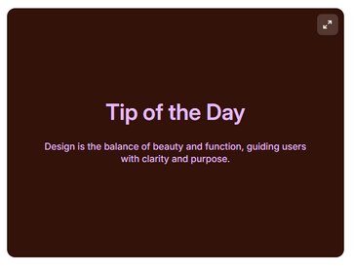
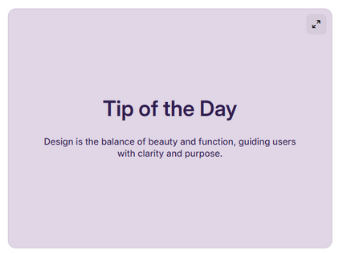
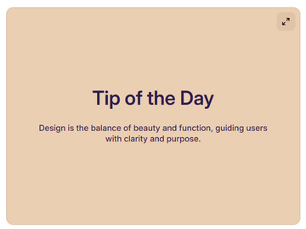
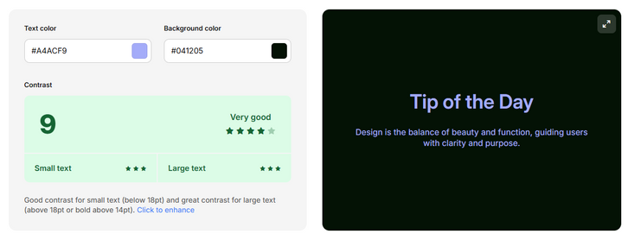
Text Color:
#E4BDF9
Background Color:
#33120A
#311F51
#72F5A6
#A4ACF9
STUDENT
#FF8080
Text Color:
#311F51
Background Color:
#E0D6E6
#EBCFB2
#041205
Text Color:
#2F1D4E
Background Color:
#EBCFB2
#17141D
#C8ABED
TEACHER
Text Color:
#A4ACF9
Background Color:
#041205
#EBCFB2
#9ACCA5

Slide 3



#17141D
LOGO:
#C8ABED
TEACHER
#A4ACF9
STUDENT
FONTS:
Montserrat
#EBCFB2
IMAGES USED:
#9ACCA5
#72F5A6
CORRECT
#FF8080
WRONG
for file handling

Slide 4
1
2
3
4
5
6
7
8
9
10
Finish Attempt
What is the powerhouse of the cell?
Cytoplasm
Nucleus
Mitochondria
Ribosomes
Prev
Next

Slide 5
1
2
3
4
5
6
7
8
9
10
Finish Attempt
What is the powerhouse of the cell?
Cytoplasm
Nucleus
Mitochondria
Ribosomes
Prev
Next

Slide 6
1
2
3
4
5
6
7
8
9
10
Finish Attempt
What is the powerhouse of the cell?
Cytoplasm
Nucleus
Mitochondria
Ribosomes
Prev
Next

Slide 7
1
2
3
4
5
6
7
8
9
10
Finish Attempt
What is the powerhouse of the cell?
Cytoplasm
Nucleus
Mitochondria
Ribosomes
Prev
Next

Slide 8
Log In
Create an Account

Slide 9

ID Number:
Password:
Log In

Slide 10

ID Number:
Password:
Log In

Slide 11
Name:
ID Number:
Create Password:
Confirm Password
Create an Account
Student

Slide 12
1
2
3
4
5
Submit
6
7
8
9
10
What is the powerhouse of the cell?
Cytoplasm
Nucleus
Mitochondria
Ribosomes
Prev
Next

Slide 13
1
2
3
4
5
Finish Attempt
6
7
8
9
10
What is the powerhouse of the cell?
Cytoplasm
Nucleus
Mitochondria
Ribosomes
Prev
Next

Slide 14
1
2
3
4
5
Finish Attempt
6
7
8
9
10
What is the powerhouse of the cell?
Cytoplasm
Nucleus
Mitochondria
Ribosomes
Prev
Next

Slide 15
Question 1
Question 6
Question 2
Question 7
Would you like to submit?
Question 3
Question 8
Yes
No
Question 4
Question 9
Question 5
Question 10

Slide 16
Would you like to submit?
Yes
No

Slide 17
Congratulations! You’ve finished it
Exit

Slide 18

Hi, Teacher Jay Vince!
Log out
Subject ID
Subject Name
Number of Students
CSIT221
Data Structures and Algorithms
42

Slide 19
Hi, Teacher Jay Vince!
Log out
CSIT227
Object - oriented Programming
CSIT121
Fundamentals of Programming
CSIT221
Data Structures and Algorithms
CSIT122
Intermediate Programming

Slide 20
Hi, Teacher Jay Vince!
Log out
CSIT227
Object - oriented Programming
CSIT121
Fundamentals of Programming
CSIT221
Data Structures and Algorithms
CSIT122
Intermediate Programming

Slide 21
Hi, Teacher Jay Vince!
CSIT227: Object - oriented Programming
Quiz 2: Abstract Classes and Interface
Quiz 1: Fundamentals of OOP
Quiz 3: Graphical User Interface
Quiz 4: OOP Design Principle

Slide 22
Hi, Teacher Jay Vince Serato!
75%
Average Performance:
Students
Score
Passed / Failed
Christian V. Buzarang
20 / 20
PASSED
Hanz Ivan L. Hermosada
20 / 20
PASSED
Ericka Fatima Reign R. Ligaray
10 / 20
FAILED
Jillian Britney Q. Oledan
20 / 20
PASSED

Slide 23
QUIZ DETAILS
Quiz Title:
ADD QUESTIONS
Question Text:
Option 1:
Option 2:
Option 3:
Option 4:

Slide 24
Add Question
Remove Question
1
2
3
4
5
6
7
8
9
10
Questions Preview:
Cancel
Save Quiz

Slide 25
Add Question
Remove Question
Questions Preview:
Cancel
Save Quiz

Slide 26
Hi, Student Juan dela Cruz!
Log out
CSIT227
Object - oriented Programming
CSIT121
Fundamentals of Programming
CSIT221
Data Structures and Algorithms
CSIT122
Intermediate Programming

Slide 27
Hi, Student Juan dela Cruz!
Back
Log out
75%
Average Performance:
Quiz
Score
Status
Quiz 1: Fundamentals of OOP
20 / 20
PASSED
Quiz 2: Abstract Classes and Interface
20 / 20
PASSED
Quiz 3: Graphical User Interface
10 / 20
FAILED
Quiz 4: OOP Design Principle
0 / 20
FAILED
Download Grade Report

Slide 28
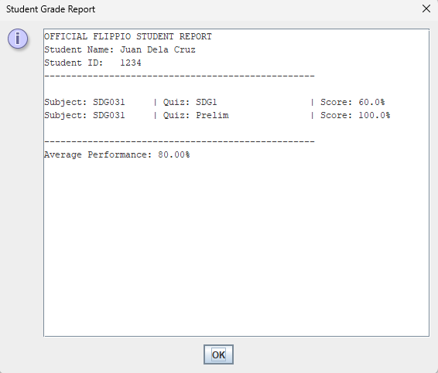
FLIPPIO STUDENT REPORT
Student: Juan Dela Cruz
ID: 1234
Subject: CSIT227
QUIZ
Quiz 1: 1.0 / 5.0 - FAILED
Quiz 2: 0.0 / 1.0 - FAILED
Quiz 3: 0.0 / 1.0 - FAILED

Slide 29
1
2
3
4
5
Submit
6
7
8
9
10
What is the powerhouse of the cell?
Cytoplasm
Nucleus
Mitochondria
Ribosomes
Prev
Next

Slide 30
Modals / Dialog Box

Slide 31


Account successfully created!
Please return to the Log In screen.
OK

Slide 32

The ID number ‘54321’ already exists.
OK

Slide 33

Login Failed
Invalid ID number or Invalid Password
OK

Slide 34


Slide 36


Slide 38
Excess Designs

Slide 39
ID Number:
Password:
Log In

